Slide 1

Europeana
Awareness Evaluation and Tracking Study – Poland Wave 2
For Eleanor Kenny, British Library
By Simon McDonald I Business Director
simon@insites-consulting.com
Emma Hargreaves I Research Manager
emma@insites-consulting.com
Date 26th July, 2013
www.insites-consulting.com
Ghent I Rotterdam I London I Timisoara I New York

Slide 2
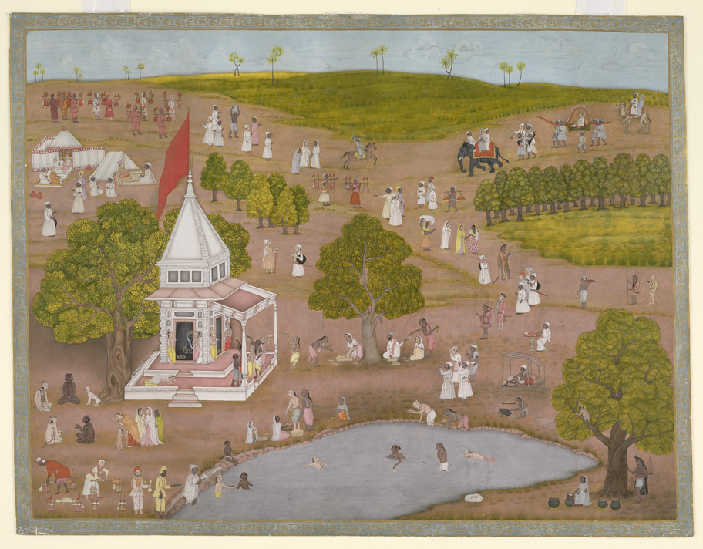


Agenda
Background & Objectives Overview
Method, Sample, Weighting
Awareness, Usage & Attitudes
Site Activation
Areas for Improvement
Q & A

Slide 3

Background & Objectives Overview

Slide 4
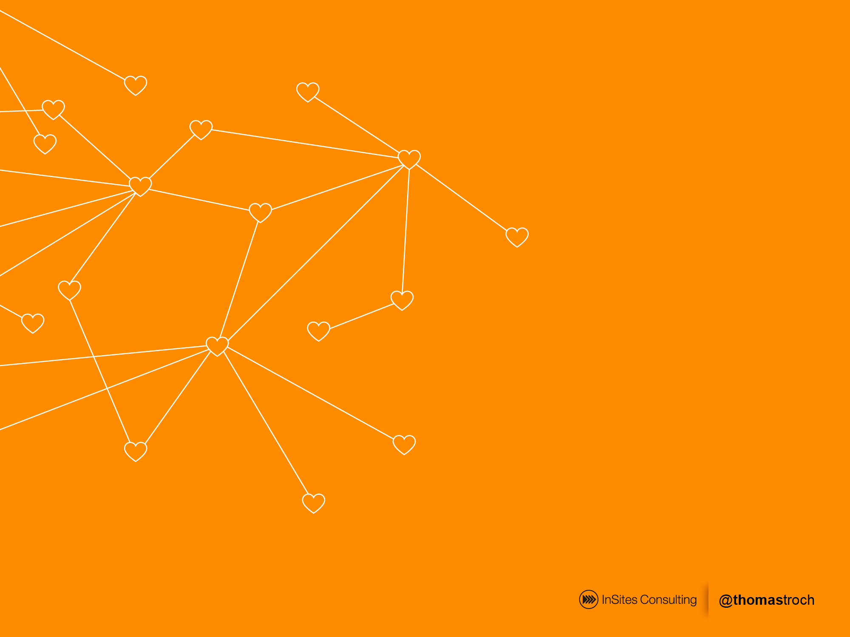



Wave one dipstick to measure awareness, usage, recommendation and attitudes to Europeana prior to marketing campaigns
Wave one
Poland
Italy
Norway
500 completed interviews in each market, March 2013
Quantitative
Online
Survey
Wave two
500 interviews in Poland, June 2013
Wave two in Poland only at the moment to measure changes in awareness, usage, recommendation and attitudes to europeana post marketing

Slide 5
Quantitative Study
Awareness and Usage
Screening
Activation
Screened for:
Interest in arts/culture/history
Visited museums, exhibitions, libraries, events in last six months
Allows for universe estimation
Awareness and usage of Europeana and competitive set
Likelihood to visit again and recommend
Source of awareness
Attitudes to Europeana
PLUS interest & awareness of the specific campaign
All respondents directed to Europeana and asked:
Attitude statements
Likelihood of returning/recommending
Likes/dislikes/suggestions

Slide 6
Sample - Screening
All respondents had to have:
Interest in arts/culture/history
Visited museums, exhibitions, libraries, events in last six months
 | Unweighted screened sample W1 | Unweighted screened sample W2
Italy | 516 | 510
Norway | 505 | n/a
Poland | 530 | 558
Total | 1,551 | 1,068
All respondents weighted by age within country (W1 and 2)

Slide 7
Sample - Weighting
NOT EDITED
 | Unweighted screened sample | Weighted and grossed
Italy | 516 (33.2%) | 24.3m (52.9%)
Norway | 505 (32.6%) | 1.5m (3.3%)
Poland | 530 (34.2%) | 20.1m (43.8%)
Total | 1,551 respondents | 45.9m people

Slide 8
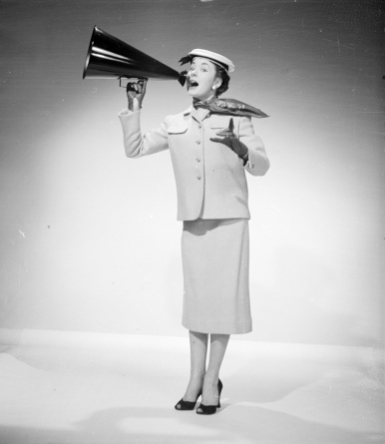
Awareness
Pre-activation

Slide 9


Overall Awareness of Europeana was low (wave 1)
Only 9% of all respondents are aware of Europeana
12%
Italy
10%
Italy (W2)
4%
Norway
6%
Poland
9

Slide 10
Overall Awareness of Europeana - Poland
Awareness in Poland has increased in the second wave
6%
Poland (wave 1)
14%
Poland (wave 2)
10

Slide 11
Where has awareness changed?
Increase in awareness occurs amongst those:
Very interested in art
Across age groups – especially 35-44 year olds
11

Slide 12

How did the 1989 campaign perform?
Political and social transformation (changes) related to the year 1989
EXTRA
QUESTIONS
Objectives
As the campaign is not wholly based on the promotion of the europeana brand, two additional questions were added in wave 2. These were designed to measure both the interest in the campaign topic and the awareness of campaign events. This allows us to analyse results using these new sub-groups.
Campaign related questions:
How interested are you in reading or learning about the political and social transformation (changes) related to the year 1989?
Events and exhibition have been organised by Europeana regarding period of political transformation related to 1989. Have you seen, read or heard anything about these events and exhibitions in the last month?
Campaign logo:

Slide 13
1989 specifics
There is a high level of interest in the campaign topic, almost 1/3 of people are aware of the campaign
82%
are interested in the campaign topic
31%
are aware of the campaign
13

Slide 14
1989 specifics - profile
Those aware of the 1989 campaign are younger men with a greater interest in arts and culture.
 | Aware | Not aware
Male | 57% | 48%
Female | 43% | 52%
18-24 | 22% | 31%
25-34 | 38% | 27%
35-44 | 20% | 23%
45-54 | 10% | 10%
55-65 | 10% | 9%
Very interested in arts/culture | 62% | 34%
Quite interested in arts/culture | 38% | 66%
 | Interested | Not interested
Male | 52% | 44%
Female | 48% | 56%
18-24 | 28% | 28%
25-34 | 29% | 35%
35-44 | 22% | 23%
45-54 | 12% | 5%
55-65 | 9% | 8%
Very interested in arts/culture | 46% | 29%
Quite interested in arts/culture | 54% | 71%
14

Slide 15
1989 specifics – awareness/usage of europeana
And interest and awareness of the 1989 events and exhibitions increases awareness of europeana
2.7 times more likely to be aware if interested in 1989 events
15
Notes:
How interested are you in reading or learning about the political and social transformation (changes) related to the year 1989?
Events and exhibitions have been organised by Europeana regarding period of political transformation related to 1989. Have you seen, read or heard anything about these events and exhibitions in the last month?

Slide 16
1989 specifics – awareness/usage of europeana
And interest and awareness of the 1989 events and exhibitions increases awareness of europeana
2.7 times more likely to be aware if interested in 1989 events
7.4 times more likely to be aware if aware of the 1989 exhibitions
2.0 times more likely to have used europeana in the last month
16
Notes:
How interested are you in reading or learning about the political and social transformation (changes) related to the year 1989?
Events and exhibitions have been organised by Europeana regarding period of political transformation related to 1989. Have you seen, read or heard anything about these events and exhibitions in the last month?

Slide 17
Why might this be?
Thoughts around awareness:
Awareness in Poland has more than doubled and can be attributed to the 1989 campaign at least in part
Interest in the topic was high
Awareness of the exhibitions was high
Those aware of the exhibitions were 7 times more likely to be aware of europeana than those where not aware
17

Slide 18

Awareness of europeana has increased
AIDED
AWARENESS
Objectives
W2
W1
Aware of europeana
Index
Wikipedia
92% | 89% | 87%
53% | 48% | 50%
32% | 29% | 47%
14% | 6% | 100%
2% | 4% | 0%
103
110
110
233
50
Google Books
Google Art Project
europeana
None of these
MARKET SPECIFIC:
www. cyfrowe.mnw.art.pl
40% | 32% | 66%
22% | 17% | 82%
125
129
www. fbc.pionier.net.pl
Q8. Which of the following websites which contain art, museum collections, digitised books and cultural history are you aware of?
Base: Poland n=558

Slide 19
Awareness of europeana has increased
AIDED
AWARENESS
Objectives
Interested in arts & culture
Interested in 1989 events
Aware of 1989 exhibition
W2
Wikipedia
92% | 90% | 94% | 87%
53% | 60% | 56% | 58%
32% | 42% | 34% | 45%
14% | 27% | 16% | 37%
2% | 2% | 0% | 0%
Google Books
Google Art Project
europeana
None of these
MARKET SPECIFIC:
www. cyfrowe.mnw.art.pl
40% | 60% | 45% | 65%
22% | 36% | 24% | 40%
www. fbc.pionier.net.pl
Q8. Which of the following websites which contain art, museum collections, digitised books and cultural history are you aware of?
Base: Poland n=558

Slide 20



Impact has been made with increased awareness via media and conferences/exhibition *
AWARENESS
SOURCE
W2
wave 1
41%
31%
33%
14%
29%
26%
10%
7%
12%
W1
* NB – low base size
Q11. How did you first become aware of the europeana website?
Base: All aware of europeana n=80

Slide 21

Website Usage
Pre-activation

Slide 22


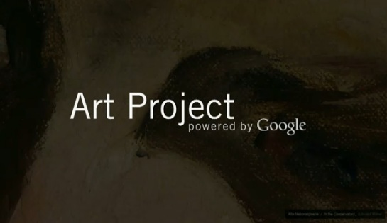
Usage amongst those aware is growing with 2 in 3 having used euporeana in the last month
WEBSITE
USAGE
Objectives
PAST MONTH TOTAL
POLAND – WAVE 2
(ranked on past month total)
W2
Trend
Aware of 1989 campaign
93% | -1%
74% | 7%
72% | -5%
63% | 8%
61% | -3%
60% | 14%
95%
83%
84%
79%
73%
73%
www.fbc.pionier.net.pl
www.cyfrowe.mnw.art.pl
Q9. And which have you visited in the last six months at all? Please indicate when you last visited each site.
Base: Poland, aware of website
Wikipedia n=513; europeana n=80; Google Books n=269; www.fbc.pionier.net.pl n=123; Google Art Project n=178; www.cyfrowe.mnw.art.pl n=223

Slide 23
…europeana usage is still low across the entire population – but increasing as awareness increases
WEBSITE USAGE
TOTAL
Used in last 4 weeks
All respondents in Poland
Q9. And which have you visited in the last six months at all? Please indicate when you last visited each site.
Base: Poland all n=558

Slide 24
Future intended usage of europeana is still high amongst those aware
FUTURE
USAGE
Objectives
LIKELY TOTAL
POLAND – WAVE 2
(ranked total very/quite likely)
W2
Trend
Aware of 1989 campaign
98% | 0%
94% | -3%
91% | 0%
89% | -3%
89% | 4%
85% | -9%
99%
95%
93%
94%
87%
90%
www.cyfrowe.mnw.art.pl
www.fbc.pionier.net.pl
Q10. And how likely are you to visit each of these sites in the next six months? Please indicate for each site
Base: Poland, aware of website
Wikipedia n=513; europeana n=80; Google Books n=269; www.fbc.pionier.net.pl n=123; Google Art Project n=178; www.cyfrowe.mnw.art.pl n=223

Slide 25
Likelihood of using again has improved due to increased awareness/usage but is still low amongst the general population
FUTURE USAGE
TOTAL
Very likely to use again in the next 6 months
All respondents in Poland
Q10. And how likely are you to visit each of these sites in the next six months? Please indicate for each site
Base: Poland all, n=558

Slide 26
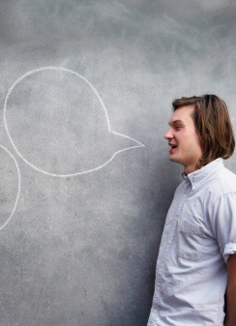
Attitudes towards europeana
Pre-activation

Slide 27


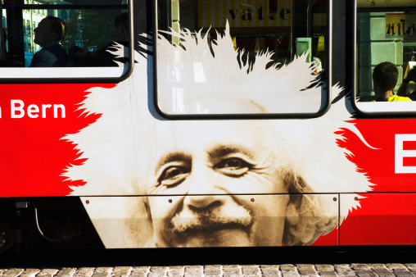
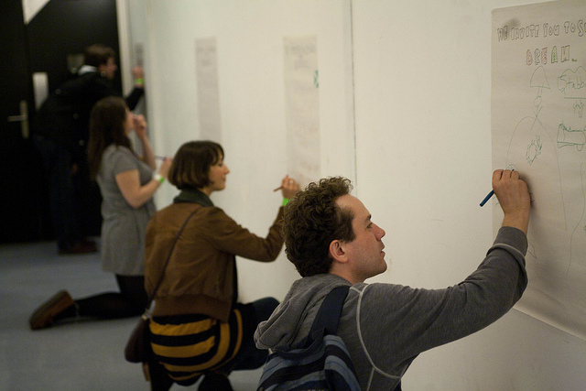
Current strengths of Europeana
Wave 2
58%
Wave 2
57%
Wave 2
52%
…is an authoritative source of cultural information
…is a site that I would recommend to my friends/colleagues who were interested in arts/culture
….a site where you can access millions of books, films, paintings and museum objects
Top box agreement with statement (totally agree)
Statements included here were the top strengths as identified at a total level in wave 1
Q12, What have you heard about Europeana? Please answer each statement, saying how much you agree or disagree
Base: All aware of europeana n=118; Italy n=65; Norway n=18; Poland n=35

Slide 28
How unique is Europeana? two thirds can get the same info elsewhere
CURRENT STRENGTHS
FUTURE
EUROPEANA
Objectives
AGREE
DISAGREE
Site with millions of books etc.
85% |  |  | 5%
89% |  |  | 3%
90% |  |  | 6%
80% |  |  | 7%
66% |  |  | 24%
Authoritative source
Recommendation
New way to explore
Can get the same somewhere else
Q12, What have you heard about Europeana? Please answer each statement, saying how much you agree or disagree
Base: Poland all aware of europeana. Wave 2 n=80

Slide 29
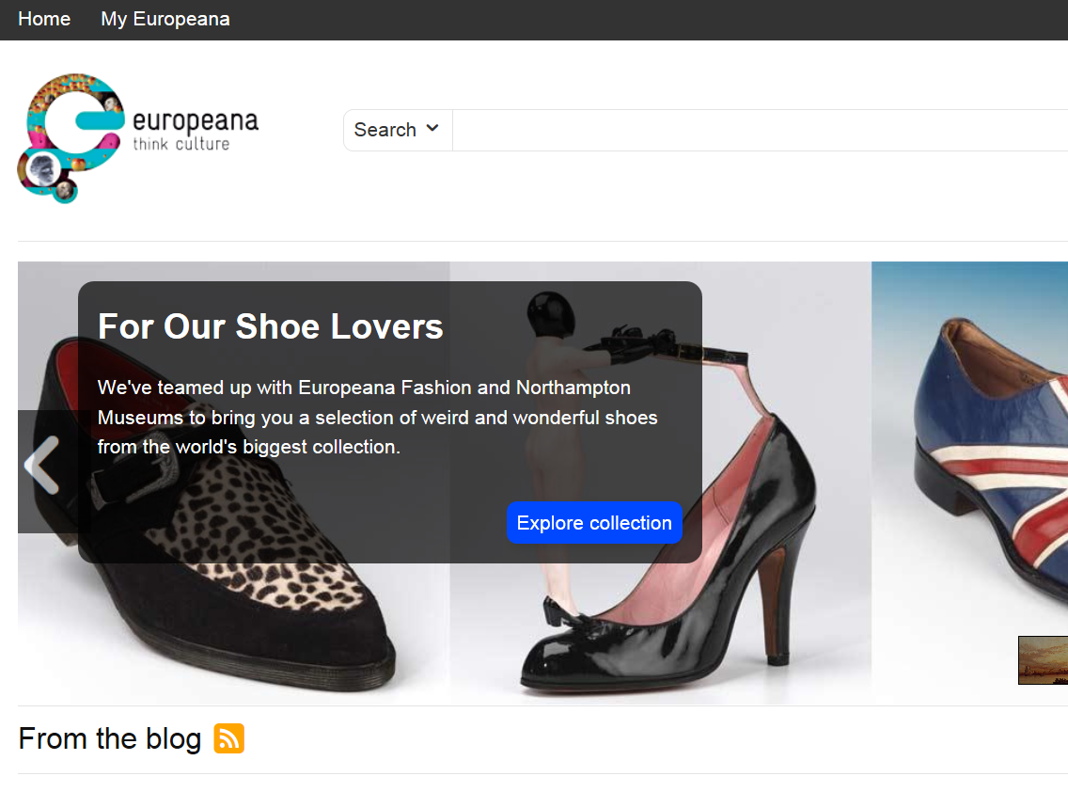
Activation
Survey directs participants to the webpage of europeana…
“Please take a few minutes to take a look at the website, and then come back to this window and answer the following short questions. “
Those already aware of europeana also take part in this task.

Slide 30
Attitudes towards europeana
Post-activation

Slide 31
Post activation, recall of the website attributes is more positive versus the reality
FUTURE
WEBSITE
ACTIVATION
Objectives
Agreement among those aware of europeana (post activation scores)
Activation impact
Top 2 box % - totally/slightly agree
Authoritative source
-4%
-5%
3%
NA
-8%
NA
-4%
Recommendation
New way to explore
Easy to navigate
Site with millions of books etc.
Find most things I wanted
Can get the same somewhere else
Q12. What have you heard about Europeana?
Q13. Now that you have visited the Europeana website, please take a look at the statements below. Please answer each statement, saying how much you agree or disagree.
Base: All aware of europeana – wave 2 n=80;

Slide 32
Website opinion is positive among non-users when activated – but less than current users
FUTURE
WEBSITE
ACTIVATION
Objectives
Post activation scores
Agreement
Top 2 box % - totally/slightly agree
Authoritative source
Aware
85%
68%
85%
72%
83%
65%
78%
64%
77%
62%
74%
53%
60%
54%
Not aware
Recommendation
Aware
Not aware
New way to explore
Aware
Not aware
Easy to navigate
Aware
Not aware
Site with millions of books etc.
Aware
Not aware
Find most things I wanted
Aware
Not aware
Can get the same somewhere else
Aware
Not aware
Q13. Now that you have visited the Europeana website, please take a look at the statements below. Please answer each statement, saying how much you agree or disagree. Base: Aware of europeana – n=80; not aware n=478

Slide 33
Usage Intention
Post-activation

Slide 34
Future usage
FUTURE
CURRENT USAGE
13% P6M
Objectives
Future usage – likely to use europeana in the future
P6M = Past 6 months
Base: Total sample W2
Top 2 box % - very/quite likely
Index
1.25
1.22
1.39
1.27
Total W2
Aware of Europeana
Not aware of Europeana
Very interested in culture
Quite interested in culture
Interested in campaign topic
Not interested
Aware of campaign
Not aware
Q9. And which have you visited in the last six months at all? Please indicate when you last visited each site.
Q14. How likely are you to visit this site again in the future?
Base: Already aware of europeana n=478 not aware n=80

Slide 35

What are people saying about europeana?
Post-activation

Slide 36


1. Interesting & useful content
“It is very clear, intriguing and interesting. It is about many fascinating topics. It is mysterious, appealing and mesmerizing. A lot of topics interest me.”
LIKES
2. To seek information & to be informed – general or in relation to a specific event/exhibition etc.
3. Is detailed and complete with a wealth of information
4. To learn...to expand current knowledge or to explore the site in more detail.
5. Easy to use and has relevent content
Why are you likely to visit the site again? What made makes you want to come back?
Base: Very / quite likely to visit europeana again n=451

Slide 37

1. Language issues/constraints
“It can not be fully translated into Polish, even after I tried several times.
DISLIKES
2. Unclear & complex – “the site is not very user-friendly, I was several minutes on it and couldn't find out anything, I do not know where to look”
3. User-freindliness - “Navigation is poor… it is difficult for me to find my way on the site, the page is chaotic”
4. Prefer other sites – “All of the information the website contains I can find on other, more friendly sites”
5. Layout and design - “It's too simple, i.e. it is only a search engine and a few titles and its appearance is like a typical blog with random articles”
Why are you not likely to visit the site again? What did you not like about the site?.
Base: Not very likely / not at all likely to visit europeana again n=107

Slide 38
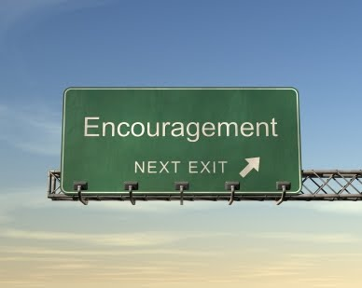
Encouraging future usage
Post-activation

Slide 39
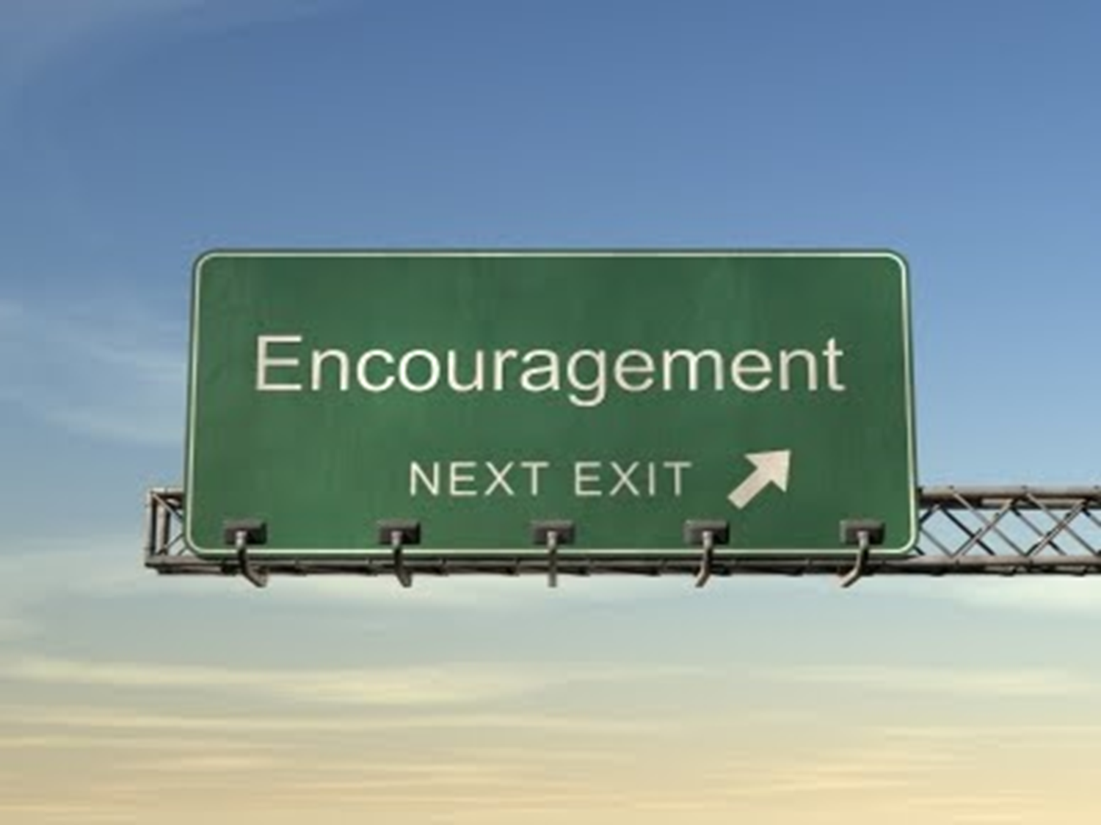
ENCOURAGING
Language (35%)
USAGE/IMPROVEMENTS
Objectives
1
Extend/complete translation
Clarity (9%)
2
Minimise clutter
Navigation (6%)
3
Intuitive & simple
Design (5%)
4
Visually sell yourself
Search facility (4%)
5
Improved functionality

Slide 40
Language is a barrier to utilise the site, improved graphics will encourage repeat visits
ENCOURAGING
USAGE/IMPROVEMENTS
Objectives
Language & translation
Clarity
The extent of the current translations is a barrier: translations are limited i.e. they do not extend to all functions/sections of the website.
Users commented that despite selecting their preferred language, majority of the information appears in English.
Some believed this was a fault, whilst others believe it makes the site unusable.
Homepage in particular needs to me more transparent: users see it as chaotic and unorganised.
Demand for a task bar/menu function down the side of the page to improve the appearance and functionality of the home page.
“If the Polish language is selected, only part of the description changes from English.”
“It should be more transparent, with clear navigation, preferably adding a taskbar on the left side.”
“Certainly the translations of the information into the Polish language. There is a language option, but it only changes the menus”
“Improve the readability and ease of finding information”
“The Polish translation leaves a lot to be desired”
“Clearly separate the articles from the headers”

Slide 41
Navigation and user experience can be optimised through design, search and signposts
ENCOURAGING
USAGE/IMPROVEMENTS
Objectives
Navigation
Design
Simpler, easier & clearer: current design means navigation is not intuitive.
Whilst the limited availability of translations will impact on ease of navigation, there is demand for a clearer understanding of content and topics on the site.
Overall need to simplify the navigation, making the site accessible to more users.
Exiting, colourful & inviting: opportunity to ‘delight’ users with improved content and homepage.
It’s not clear to everyone from the homepage, what to expect from the site.
Combined with improved graphics, users recommend improving the layout with clearer paths for navigation.
“Change navigation, it is uncomfortable and not very intuitive”
“Change the design to "more classic", a modern metro-like appearance is unreadable to me”
“The sites navigation is not very good, there are no categories, no suggestions and no introductions”
“At the moment it looks too messy without a good graphic design”
“I think you need to make clearer menus, with specific information that could facilitate surfing the website”
“Could use a better graphic design, as long as it stays as simple as the current one”

Slide 42
Encourage exploration of the site with an improved the search facility
ENCOURAGING
USAGE/IMPROVEMENTS
Objectives
Improve the search engine: currently the tool is not offering users what they need.
It is not finding the information sought and the options are not as desired.
Search facility
“Search machine is strange, after entering the word Schleswig-Holstein, the information displayed was quite different than I expected”
“I can find a lot of interesting things and themes here but I don't really like the search options”

Slide 43

Who will help you promote the site?

Slide 44
Advocacy Barometer
Recommendation
Advocates
Indifferent
Opponents
74% (67%)
13% (18%)
9% (8%)
(Figures in brackets refer to wave 1 scores for Poland)
Q13. Europeana is a site that I would recommend to my friends/colleagues who were interested in arts/culture.
Base: Poland total wave 2, n=558; wave 1 n=530

Slide 45
Advocacy Barometer Score
Take your opponents away from your advocates
Poland sees an increase of 5 points
W2
+65
Advocates
Opponents
+100
+60
0
-100
W1
Barometer Score = Advocates - Opponents
Barometer scores uses the following statement at post-activation: Europeana is a site that I would recommend to my friends/colleagues who were interested in arts/culture.

Slide 46
Advocacy Barometer
Chase the Promoters – trend scores
Work in culture/education
Increase of 9 points
W2 = +71
W1 = +62
Advocates
Opponents
+100
W1 = +68
0
-100
W2 = +78
Interested in culture
Increase of 10 points
Barometer Score = Advocates - Opponents
Barometer scores uses the following statement at post-activation: Europeana is a site that I would recommend to my friends/colleagues who were interested in arts/culture.

Slide 47
Advocacy Barometer
Chase the Promoters - campaign impact
Aware of campaign +75
Not aware of campaign +61
Advocates
Opponents
+100
0
-100
Interested in campaign topic +71
NOT Interested in campaign topic +46
Barometer Score = Advocates - Opponents
Barometer scores uses the following statement at post-activation: Europeana is a site that I would recommend to my friends/colleagues who were interested in arts/culture.

Slide 48
Summary
Awareness in Poland has more than doubled
Much clearer picture than in Italy where awareness was flat
One third were aware of the 1989 campaign
Increase in awareness can be directly attributed to awareness of the 1989 campaign
Those aware were 7 times more likely to be aware of europeana
And a clear trend in increased awareness of europeana through exhibitions and social media
Visits amongst those aware of europeana are high – visits amongst total population are low but increasing
Attitudes to the website are positive
But there are many opportunities to enhance the user experience

Slide 49
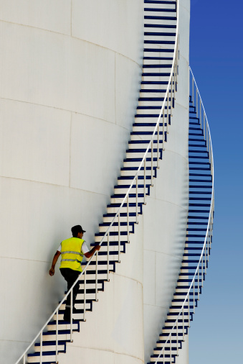
Next Steps
Schedule wave 2 Fieldwork dates:
Norway

